Slide 1
WELCOME
PRESENTATION BY
AKITI SRI KALYAN REDDY

Slide 2
Digital marketing
*Digital marketing is the act of promoting and selling products and services by leveraging online marketing tactics such as social media marketing, search marketing, and email marketing.
*digital marketing typically refers to marketing campaigns that appear on a computer, phone, tablet, or other device.
*its also called as online marketing

Slide 3
Difference between traditional and digital marketing
TRADITIONAL MARKING
1)it includes print media, broadcast media,directmail or post
2)Not cost effective
3) Can't target audience
4) can't measure
5)not common platform for everyone
6) Can't get feedback
7)Fast and effective in brand building
DEGITALMARKING
1) Through the electronic medium
2) cost effective
3)It can easily target audience
4)Larger number of audience (measurable
5) common platform
6)let's feedback
7) not so effective in brand building

Slide 4
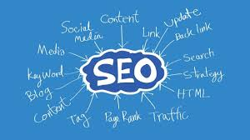
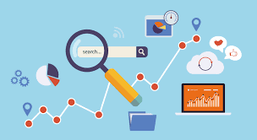
Types of digital marketing
1)SEO
SEO stands for “search engine optimization.” In simple terms, it means the process of improving your site to increase its visibility when people search for products or services related to your business in Google, Bing, and other search engines. The better visibility your pages have in search results, the more likely you are to garner attention and attract prospective and existing customers to your business.

Slide 5

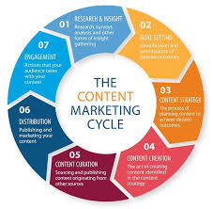
2) content marketing
It is a strategy based on the distribution of relevant and valuable content to a target audience.
As in any marketing strategy, the goal of content marketing is to attract leads that ultimately convert into customers. But it does so differently than traditional advertising. Instead of enticing prospects with potential value from a product or service, it offers value for free in the form of written material.

Slide 6
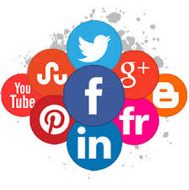
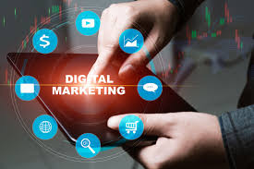
3) SMM (social media marketing)
Social media marketing means driving traffic and brand awareness by engaging people in discussion online. The most popular platforms for social media marketing are Facebook, Twitter, and Instagram, with LinkedIn and YouTube not far behind.
Social media marketing offers built-in engagement metrics, which are extremely useful in helping you to understand how well you're reaching your audience. You get to decide which types of interactions mean the most to you, whether that means the number of shares, comments, or total clicks to your website.

Slide 7
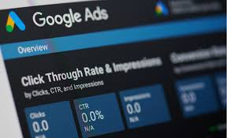
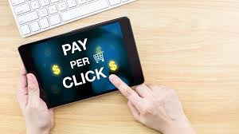
4)Pay-per-click marketing
Pay-per-click, or PPC, is posting an ad on a platform and paying every time someone clicks on it.
Example: Google ads, Bing ads

Slide 8
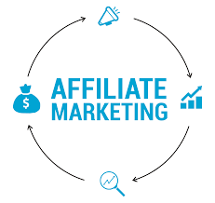

5)Affiliate marketing
Affiliate marketing lets someone make money by promoting another person's business. You could be either the promoter or the business who works with the promoter, but the process is the same in either case.
It works using a revenue sharing model. If you're the affiliate, you get a commission every time someone purchases the item that you promote. If you're the merchant, you pay the affiliate for every sale they help you make.

Slide 9
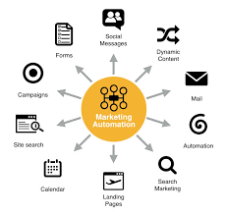
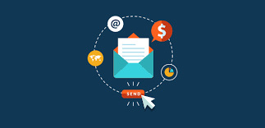
6)Marketing automation
Marketing automation uses software to power digital marketing campaigns, improving the efficiency and relevance of advertising.
7)Email marketing
The concept of email marketing is simpe if you send a promotional message and hope that your prospect clicks on it applies for your content. However, the execution is much more complex. First of all, you have to make sure that your emails are wanted.Email marketing is proven as effective technique

Slide 10
Benefits of digital marketing
1)A broad geographic reach:People can see your post from any place
2)Cost efficiency: makes in low budget
3) Quantifiable results: it give best results
4)Easier personalization: allows you to gather customer data in a way that offline marketing can't.
5)More connection with customers: lets you communicate with your customers in real-time.
6)Easy and convenient conversions: lets your customers take action immediately after viewing your ad or content

Slide 11


